Slide 1

US Census Data – Case Study
- Onkar Suhas Samant

Slide 2
Brief Overview
Dataset: Census income dataset (1990)
32K records and 14 columns
Key questions answered
What are the factors for high vs low income?
Who would be the successful investors?
What is the impact of each factor on the high / low income class?
How can we predict if a person has high / low income?
Tool used – Python

Slide 3
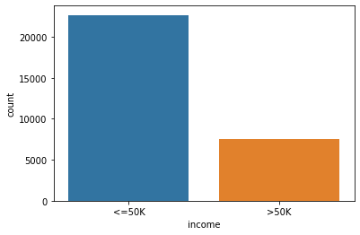
Dataset Information
The data is extracted from 1994 Census database by UCI
There are 14 features / variables and 1 class i.e. income-class (<=50K: high income, >50K: low income) and 32K records
It contains only adult (age >=17) population with mean age 38
Other variables are race, education years, working-class, occupation, sex, native-country, marital-status , capital gain / loss etc.
Most of the data consists of people who are White, are of private working-class, native-country USA and income-class <= 50k (75%)
Most of the population is above 28 years, has 9 years of education and works for more than or equal to 40 hours per week.
Income-class Counts
Legend: low income <=50K , high income > 50K,

Slide 4
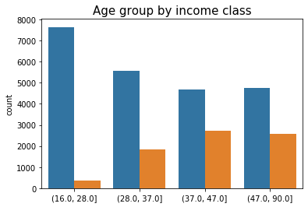
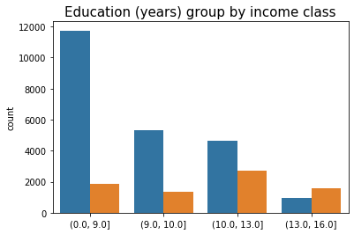
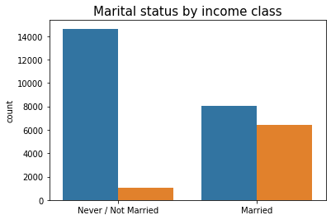
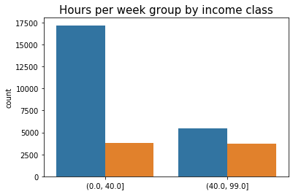
Factors for low / high income
Most important factors - Age, education, marital-status and work hours per week
High-income class proportion increases with age.
Age between (37,47] have a very high proportion on high-income class.
Proportion of high-income class increases with number of years of education
Education years between (13,16] have majority high-income class
Married people have much higher proportion of high-income class.
45% of the married people belong to high-income class while only 7% from never/not married people belong to this group.
People who work more than 40 hours per week have a higher proportion of high-income class people
Legend: low income <=50K , high income > 50K,

Slide 5
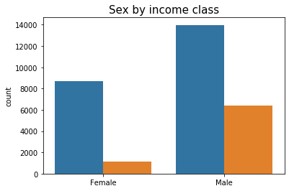
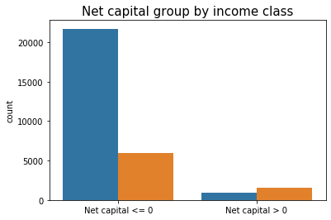
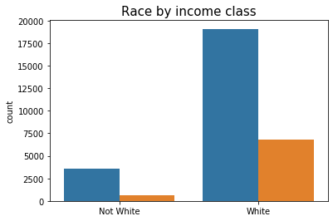
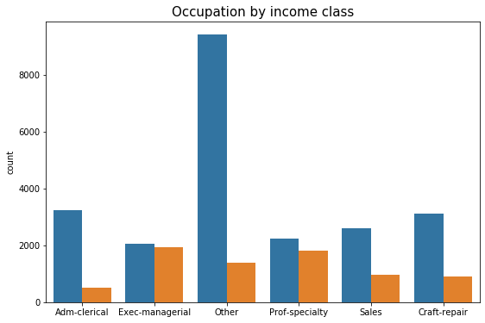
Factors for low / high income (continued)
Other important factors
Sex – Men have significantly higher proportion (31%) of people with high-income class compared to women (11%)
Net-capital gain – People with positive net-capital (capital-gain – capital-loss) have a significantly higher proportion of high-income (63%) as compared to net-capital zero or negative (21%)
Race – Whites have higher proportion of high-income class (26%) as compared to other races (16%)
Occupation– Exec-managers and Specialty profession have significantly higher proportion of high-income class
Working-class – Government and Self-employed people have higher proportion of high-income class
Native-country – US born have higher proportion of high-income class (26%) as compared to others (19%)
Legend: low income <=50K , high income > 50K,

Slide 6
Who would be the successful investors?
Assumption – People who have positive net-capital (capital-gain – capital-loss) this year would be successful investors
Technique - Compare different features of people with positive net-capital with the other population
Few Key Distinctive features – positive net-capital group:
63% this group belongs to high income-class compared to only 21% of the other population
68% of the group is married, compared to 45% of the other population
43% of the group work as executive managers or in specialty professions compared to 25% of the other population
Conclusion: People belonging to high-income class, are married and are working as executive managers or in specialty profession are estimated to be the successful investors
Note: No statistical tests have been used for simplicity

Slide 7
Impact of factors on income-class
Motivation: Impact of stand-alone factors can be overestimated. Therefore, all important features are selected together, and each feature’s impact is quantified.
Technique – Logistic Regression with important features and it’s interpretation in terms of odds ratio
Few key interpretations:
Marital status – Married people have 7.5 times odds of high-income class
Net capital – If net-capital is positive it increases odds of high-income class by 4.9 times
Education – Unit increase in education years increases the odds of high-income class by 1.36 times
Sex – Men make odds of high-income class increase by 1.36 times as compared to women
Age – Increase in age by 10 years increases the odds of high-income-class by 1.3 times
Race – Whites increase the odds of high-income class increase by 1.18 times as compared to other races
Hours per week –Increase in work hours per week by 5 years increases the odds of high income-class by 1.15 times
Note: Odds ratio = Probability (high income class) / Probability (low-income class

Slide 8
Predicting high-income class people
Motivation – Predicting high-income class people can be of interest for various promotional / advertising activities
Technique –
Various classification algorithms are trained on the training data (32K records)
All the algorithms are fine tuned on their hyperparameters to give good cross-validation accuracy
Models are compared on accuracy and training-time and best models are selected
Best models are tested on the unseen data (16K records)
Results on the test-set
Conclusion –
The results obtained are excellent in terms of accuracy
XGBoost and Random Forest give the best results amongst all the classifiers
If interpretation is of importance Logistic Regression can
be used as the accuracy is comparable
model | accuracy | training time(s)
Decision Tree | 0.83 | 0.06
Random Forest | 0.84 | 1.1
AdaBoost | 0.83 | 0.69
XGBoost | 0.84 | 2.89
Logistic Regression | 0.83 | 0.06
SVM | 0.83 | 14.95
Note: Models can be fine tuned more for better accuracy

Slide 9
Future Scope
More Questions
Census data has a lot of scope for deeper analysis to answer other questions
More Analysis
More analysis can be done by occupations, marital status or working-class to understand the data more and find other patterns
Better Feature Engineering
Though a lot of work was done to engineer features, there lies a scope for betterment
Improvements in Predictive Models
Algorithms tried are fine tuned using a combination of parameters
However, further improvement can be done using parameter selection algorithms like GridSearchCV which can give the best parameters from a wider range
Statistical tests can be carried out for comparing factors affecting potential investors and other population
Tableau dashboards can be made for easier and better visualization

